Slide 1
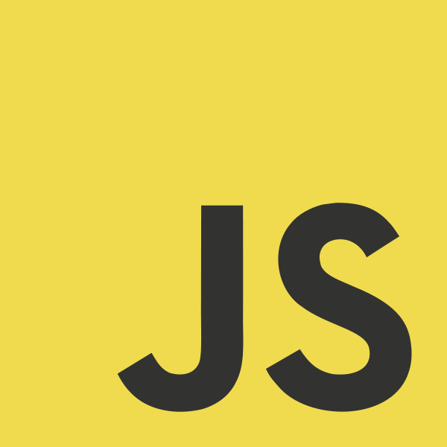
JavaScript Introduction

Slide 2
What is JavaScript?
JavaScript is a dynamic computer programming language.
Dynamic programming language is a class of high-level programming languages which, at runtime, execute many common programming behaviours that static programming languages perform during compilation.
Dynamic languages can be (but not always) frequently referred to as "scripting languages“.
Originally only executed client-side, by the user's web browser.
As opposed to server-side (on the web server).
Currently, Node.js (an open source server framework) allows you to run JavaScript on the server.
Like many dynamic languages JavaScript is dynamically typed.
At runtime, the system merely checks that a variable supports all of the operations performed on it.
JavaScript is not part of the Java platform.

Slide 3
Use in Web Pages
Loading new page content or submitting data to the server via AJAX without reloading the page
Animations of page elements
Interactive content, playing audio and video
Validating input values of a web form before submitting them to the server.
Transmitting information about the user's reading habits and browsing activities to various websites. Web pages frequently do this for web analytics, ad tracking, personalization or other purposes.
Notes:
The front-end of most sites is a combination of JavaScript and HTML and CSS.
Asynchronous JavaScript And XML – request and/or receive data from the server after the page has loaded

Slide 4
Limitations of Client-Side Scripting
Script code is embedded in the page, viewable to the world.
For security reasons, scripts are limited in what they can do.
e.g., can't access the client's hard drive directly (has to go through the browser)
Since designed to run on any machine platform, scripts do not contain platform specific commands.
Script languages are not full-featured
e.g., JavaScript objects are crude, not good for large project development

Slide 5
JavaScript Essentials
JavaScript is Case Sensitive
// single-line comment
/* multi-
-line
comment */
JavaScript Can Change HTML Content, Attributes, Styles
JavaScript Can Hide/Show HTML Elements

Slide 6
The <script> Tag
To insert a JavaScript into an HTML page, use the <script> tag.
The <script> and </script> tells where the JavaScript starts and ends.
The lines between the <script> and </script> contain the JavaScript.
You can place an unlimited number of scripts in an HTML document.
Scripts can be placed in the <body> and/or in the <head> section of an HTML page

Slide 7
Manipulating HTML Elements
To access an HTML element from JavaScript, you can use the document.getElementById(id) method.
Use the "id" attribute to identify the HTML element
The innerHTML property defines the HTML content
<!DOCTYPE html>
<html>
<body>
<h1>My First Web Page</h1>
<p id="demo">My First Paragraph.</p>
<script>
document.getElementById("demo").innerHTML="My First JavaScript";
</script>
</body>
</html>
Notes:
Ex 1

Slide 8
Functions and Events
The JavaScript statements, on the previous page, are executed while the page loads.
More often, we want to execute code when an event occurs, like when the user clicks a button.
If we put JavaScript code inside a function, we can call that function when an event occurs.

Slide 9
Functions
A function is a block of code that will be executed when "someone" calls it.
A function is written as a code block (inside curly { } braces), preceded by the function keyword.
<!DOCTYPE html> <html> <head> <script> function myFunction(){ alert("Hello World!"); } </script> </head> <body> <button onclick="myFunction()">Try it</button> </body> </html>
Notes:
Ex 2

Slide 10
External JavaScripts
Scripts can also be placed in external files. External files often contain code to be used by several different web pages.
External JavaScript files have the file extension .js.
To use an external script, point to the .js file in the "src" attribute of the <script> tag:
<!DOCTYPE html> <html> <body> <script src="myScript.js"></script> </body> </html>
External scripts can be referenced with a full URL or with a path relative to the current web page.
<script src="https://www.w3schools.com/js/myScript1.js"></script>
Notes:
Do not declare <script> again in the external .js file

Slide 11
Variables
The assignment operator (=) assigns a value to a variable
You declare JavaScript variables with the var keyword:
var carname = "Volvo";
You can declare many variables in one statement. Just start the statement with var and separate the variables by comma:
var lastname = "Doe", age = 30, job = "carpenter";
A variable declared without a value will have the value undefined.
If you re-declare a JavaScript variable, it will not lose its value because declarations are processed before any code is executed.
If you assign a value to a variable that has not yet been declared, the variable will automatically be declared as a GLOBAL variable.
Notes:
Recommendation: Always declare variables at the top of their scope (e.g., at the start of the script or a function) to provide clarity as to their scope.

Slide 12
Primitive Data Types
JavaScript has dynamic types. This means that the same variable can be used as different types:
var x; // Now x is undefined var x = 5; // Now x is a Number var x = "John"; // Now x is a String
Variables may contain values of the following primitive types: Number, String, Boolean, Null
Numbers are not allowed as the first character of identifiers.
Joining words: firstName, lastName, masterCard, interCity

Slide 13
Numbers
JavaScript has only one type of numbers. Numbers can be written with, or without decimals:
var x1=34.00; // Written with decimals var x2=34; // Written without decimals
Extra large or extra small numbers can be written with scientific (exponential) notation:
var y=123e5; // 12300000 var z=123e-5; // 0.00123

Slide 14
Strings
A string can be any text inside quotes. You can use single or double quotes:
var carname="Volvo XC60"; var carname='Volvo XC60';
You can use quotes inside a string, as long as they don't match the quotes surrounding the string:
var answer="It's alright"; var answer="He is called 'Johnny'"; var answer='He is called "Johnny"';

Slide 15
Boolean
Booleans can only have two values: true or false.
var x=true; var y=false;

Slide 16
Undefined and Null
Undefined is the value of a variable with no value.
Variables can be emptied by setting the value to null;
cars = null;

Slide 17
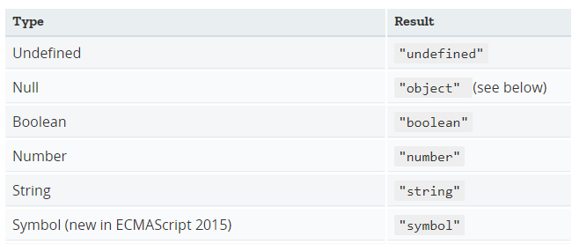

typeof
Notes:
The typeof operator returns a string indicating the type of the unevaluated operand.
typeof 42; //returns “number”
typeof [1, 2, 4]; // returns “object”
typeof new Date(); // returns “object”

Slide 18
Calling a Function with Arguments
A function in JavaScript is always passed by value, just like the primitive types
<!DOCTYPE html>
<html>
<body>
<p>Click one of the buttons to call a function with arguments</p>
<button onclick="myFunction('Bob','Builder')">Click for Bob</button>
<script>
function myFunction(name,job){ // note we don’t use “var name”
alert("Welcome " + name + ", the " + job);
}
</script>
</body>
</html>
Notes:
Ex 3

Slide 19
Comparison Operators (== vs ===)
Equality operator ==, the interpreter implicitly tries to convert the values before comparing.
function myFunction(){
var x = 5;
document.getElementById("demo").innerHTML = x == "5"; //returns true
}
Identity operator ===, does not convert values when comparing. Only true if the operands are of the same type and the contents match.
function myFunction(){
var x = 5;
document.getElementById("demo").innerHTML = x === "5"; //returns false
}
Notes:
JavaScript allows for both type–converting and strict comparisons.

Slide 20
Comparison Operators (!= vs !==)
Inequality operator !=, the interpreter implicitly tries to convert the values to an appropriate type before comparing.
var x = ‘5’;
x != 5; // returns false
Non-identity or strict inequality operator !==, does not convert values when comparing. Only true if the operands are not of the same type and the contents do not match.
var x = ‘5’;
x !== 5; // returns true
Notes:
JavaScript allows for both type–converting and strict comparisons.

Slide 21
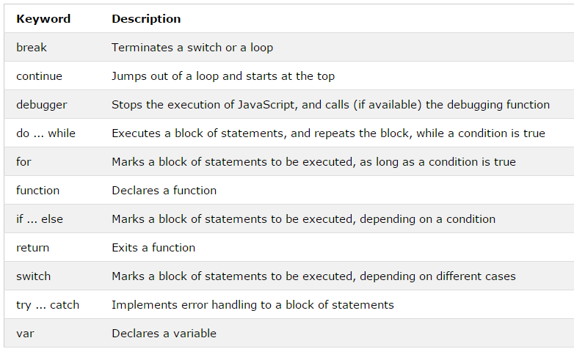
Keywords
Notes:
Also: “this”, next lecture

Slide 22
Good Practice
Use semicolons to separate JavaScript statements.
Add white space to your script to make it more readable.
put spaces around operators ( = + - * / )
Avoid code lines longer than 80 characters
If a JavaScript statement does not fit on one line, the best place to break it, is after an operator
Declare variables at the top of their scope (e.g., at the start of the script or a function) to provide clarity as to their scope.
Initialise variables on declaration.
Minimize the use of global variables.

Slide 23
Debugging
You can use the console.log() method to display data.
similar to System.out.println() in Java
Press F12 in the Browser window.
Go to “Console” to see the output.
You can also use the alert() method to display data.
Also use the browser Debugging Tools to step through and examine JavaScript code and variable states - to help track down bugs.
iOS: Cmd + Opt + I
Windows: Ctrl + Shift + I or Right Click in the Browser window, select “Inspect Elements” and then “Debugger” from the developer options shown.

